Slide 1
Climate and Soils
September 10, 2019

Slide 2
Climate

Slide 3
Climate = long term average weather
A = tropical
B = arid
C = temperate
D = cold
E = polar

Slide 4
Climate = long term average weather
Bsk = cold,
semi-arid

Slide 5
Why do we care about climate?

Slide 6
Earth’s Energy Budget

Slide 7
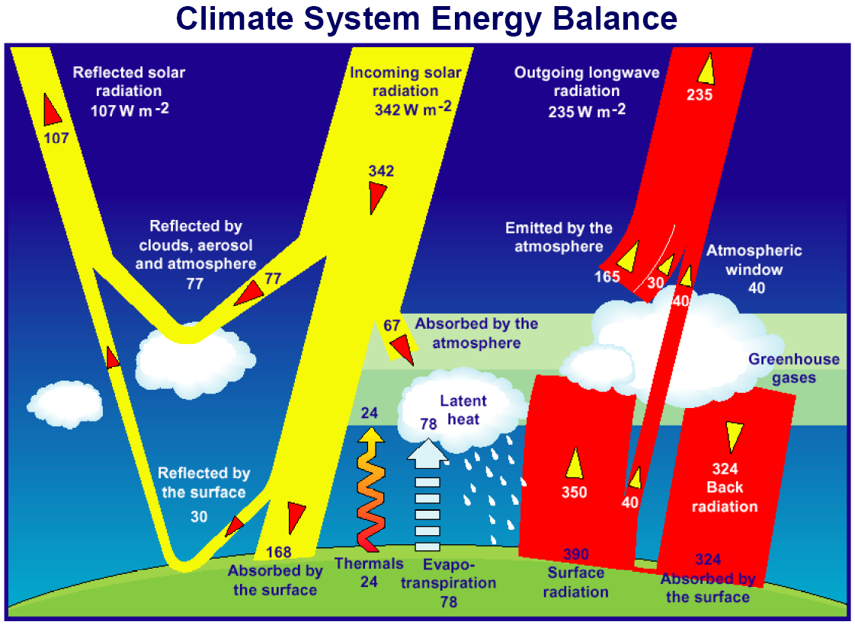

Slide 8
The planetary boundary layer:
where the turbulent fluxes happen!

Slide 10
Aerosols
Atmospheric particles
Reflect incoming radiation back to space
What’s the climate impact?

Slide 11
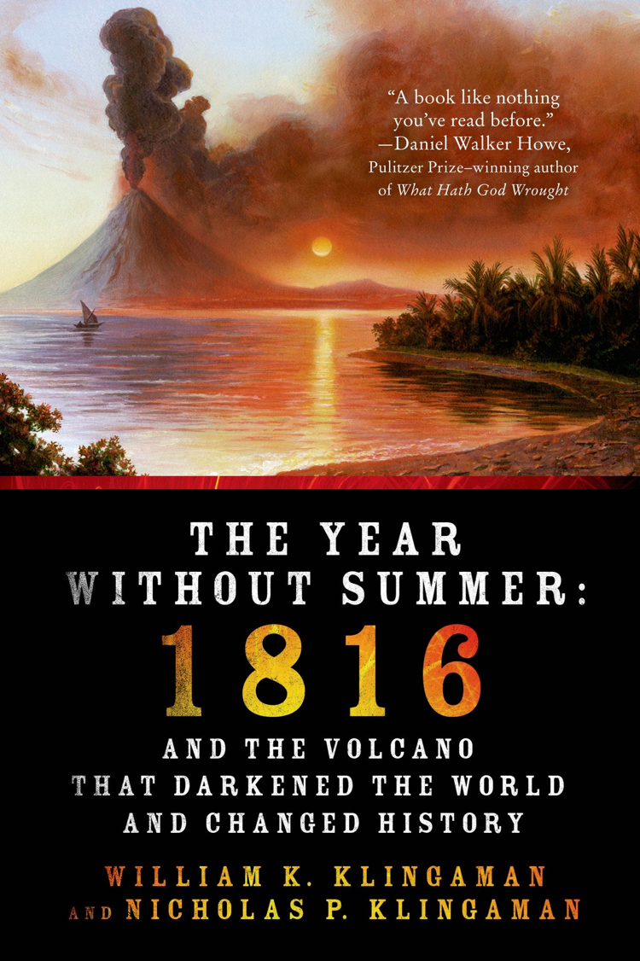

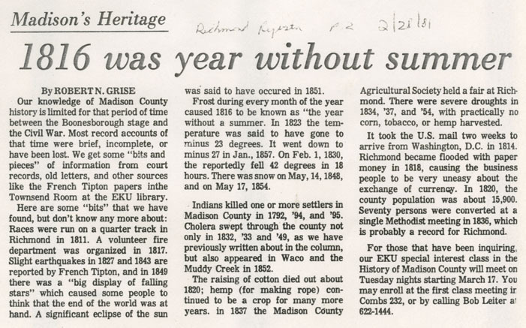
June 6th, 1816
Mount Tambora erupts (April 5th, 1815)

Slide 14
Albedo
Radiation reflected by a surface
High degree of variability in albedo of Earth’s surface

Slide 15
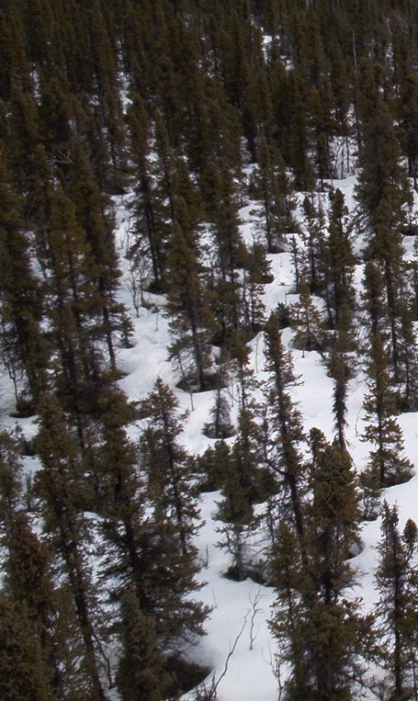
Albedo Examples
Oceans/lakes 0.03-0.10
Sea ice 0.30-0.45
Fresh snow 0.75-0.95
Tundra 0.15-0.20
Conifer forest 0.09-0.15
Broadleaf forest 0.15-0.20
Desert 0.20-0.45
Soil (wet) 0.05
Soil (dry) 0.40

Slide 16
Albedo Examples
Oceans/lakes 0.03-0.10
Sea ice 0.30-0.45
Fresh snow 0.75-0.95
Tundra 0.15-0.20
Conifer forest 0.09-0.15
Broadleaf forest 0.15-0.20
Desert 0.20-0.45
Soil (wet) 0.05
Soil (dry) 0.40
Can you rank these?

Slide 17
Amount reflected
Oceans/lakes 0.03-0.10
Sea ice 0.30-0.45
Fresh snow 0.75-0.95
Tundra 0.15-0.20
Conifer forest 0.09-0.15
Broadleaf forest 0.15-0.20
Desert 0.20-0.45
Soil (wet) 0.05
Soil (dry) 0.40

Slide 19
Greenhouse gases
Trap outgoing longwave radiation
Act like a blanket over the Earth’s surface
Keep us warm!

Slide 20
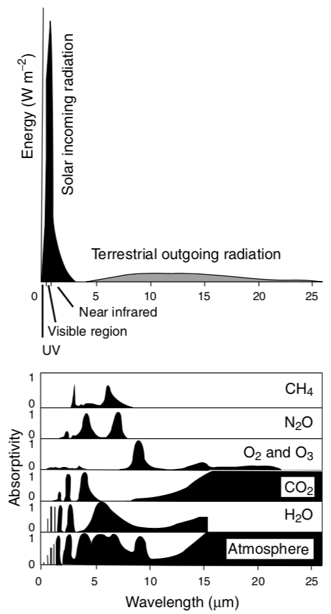
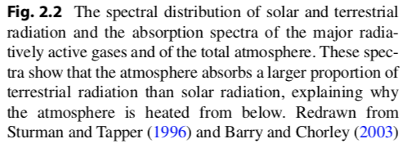

Slide 21
NOAA

Slide 22
Topography

Slide 23
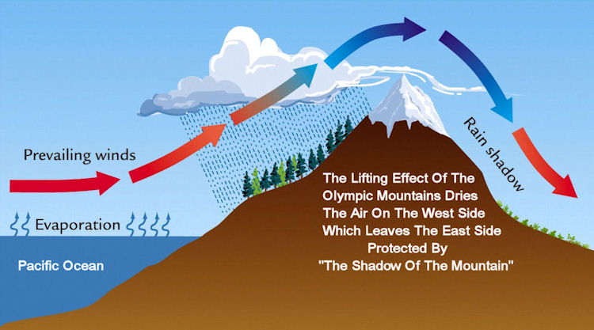
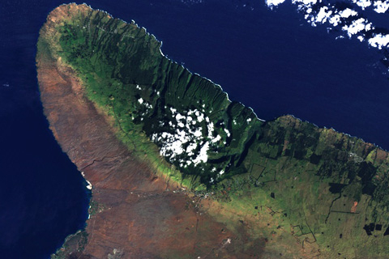
Rain Shadows

Slide 24
Vegetation

Slide 25
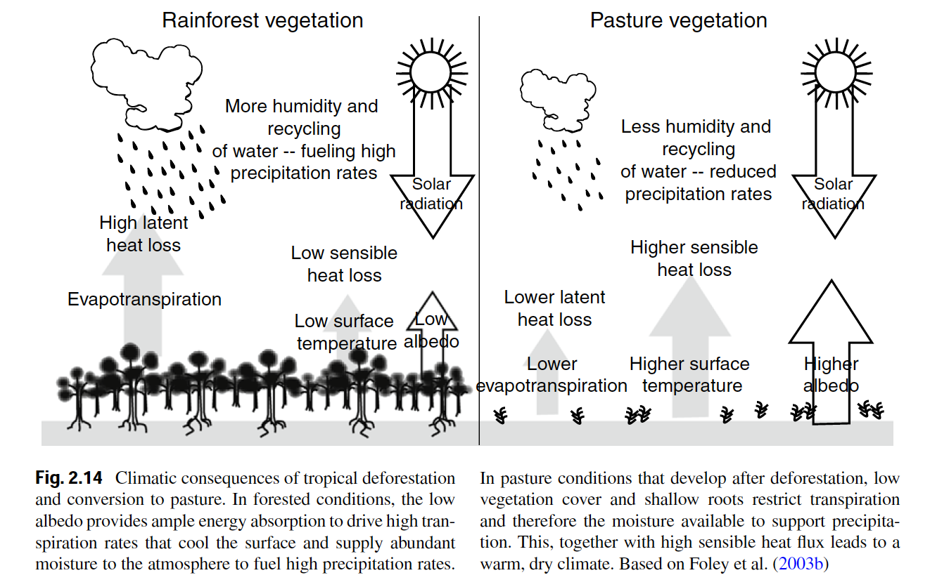
Vegetation itself can change climates

Slide 26
Long-term climate

Slide 27
Without humans would climate change over time?

Slide 28
Without life on Earth would climate change over time?

Slide 29
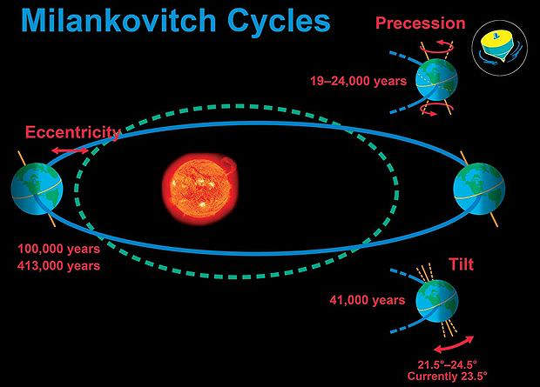

Slide 32
Soils

Slide 33
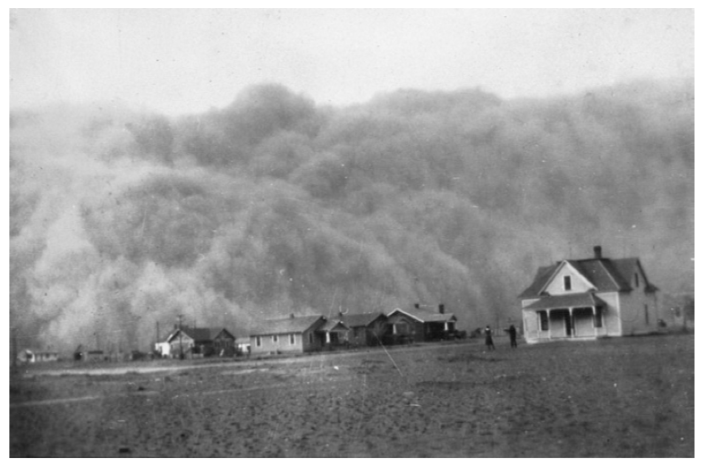
Soil Erosion and Formation

Slide 34
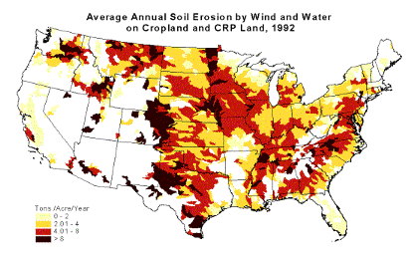
Soil Erosion

Slide 35
Erosion
Transfers carbon, nutrients and sediment from terrestrial to aquatic ecosystems
Often occurs faster than soils can be rebuilt
Leads to loss of fertility of agricultural soils

Slide 36
Erosion
Transfers carbon, nutrients and sediment from terrestrial to aquatic ecosystems
Often occurs faster than soils can be rebuilt
Leads to loss of fertility of agricultural soils

Slide 37
Formation: State factors
Parent material
Climate
Organisms
Topography/Relief
Time

Slide 38
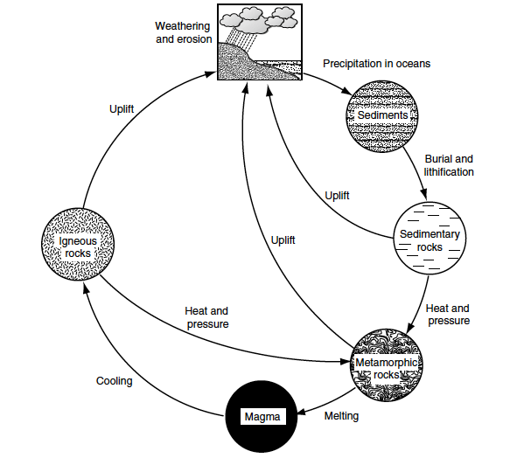
Parent Material
Physical and chemical properties of rocks
Uplift and weathering occur at different rates
100-200my

Slide 39
Climate
Temperature, moisture, CO₂, O₂
Determine weathering and soil formation

Slide 40
Organisms
Influence soil chemical and physical properties
Input litter quantity/quality
Uptake of mineral nutrients and input of organic nutrients

Slide 41
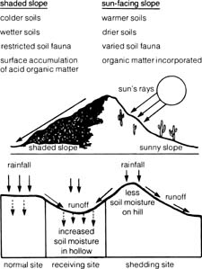
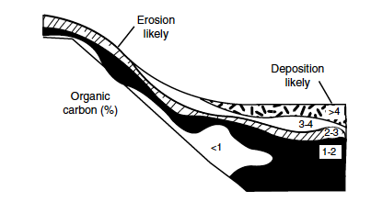
Topography
Influences climate, moisture availability, and particle transport

Slide 42
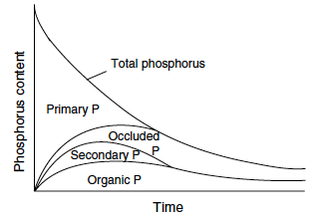
Time
Rocks weather slowly – minerals become occluded

Slide 43
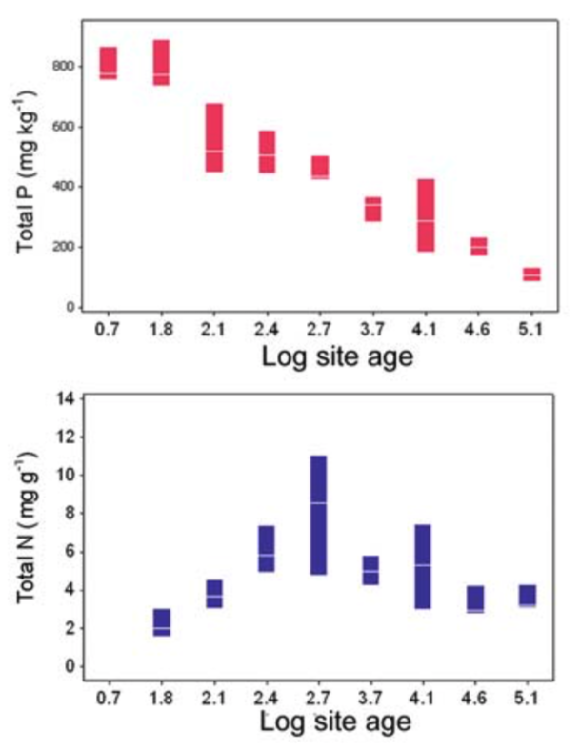
What could explain these trends?

Slide 44
Soil properties

Slide 45
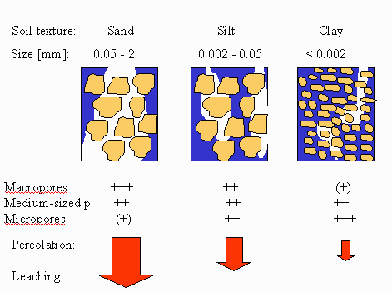
Soil Texture

Slide 46
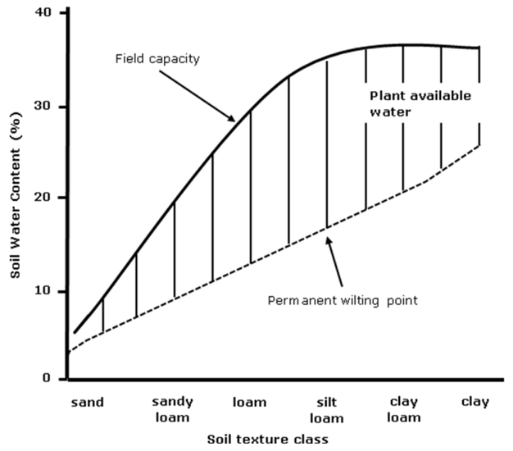
Physical: Soil texture
Sand: 0.05 – 2.0 mm
Silt: 0.002 – 0.05 mm
Clay: < 0.002 mm

Slide 47
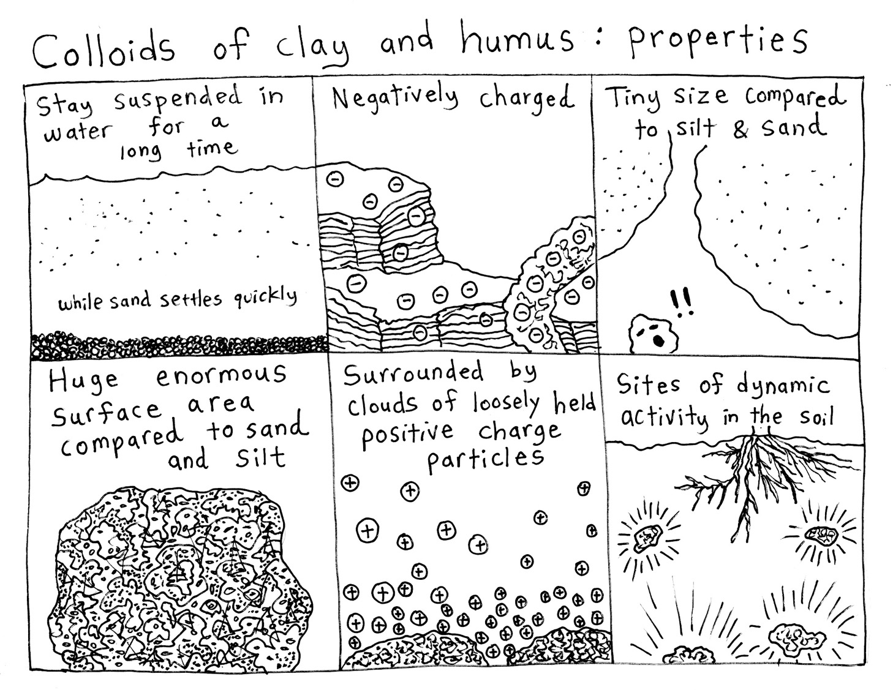

Slide 48
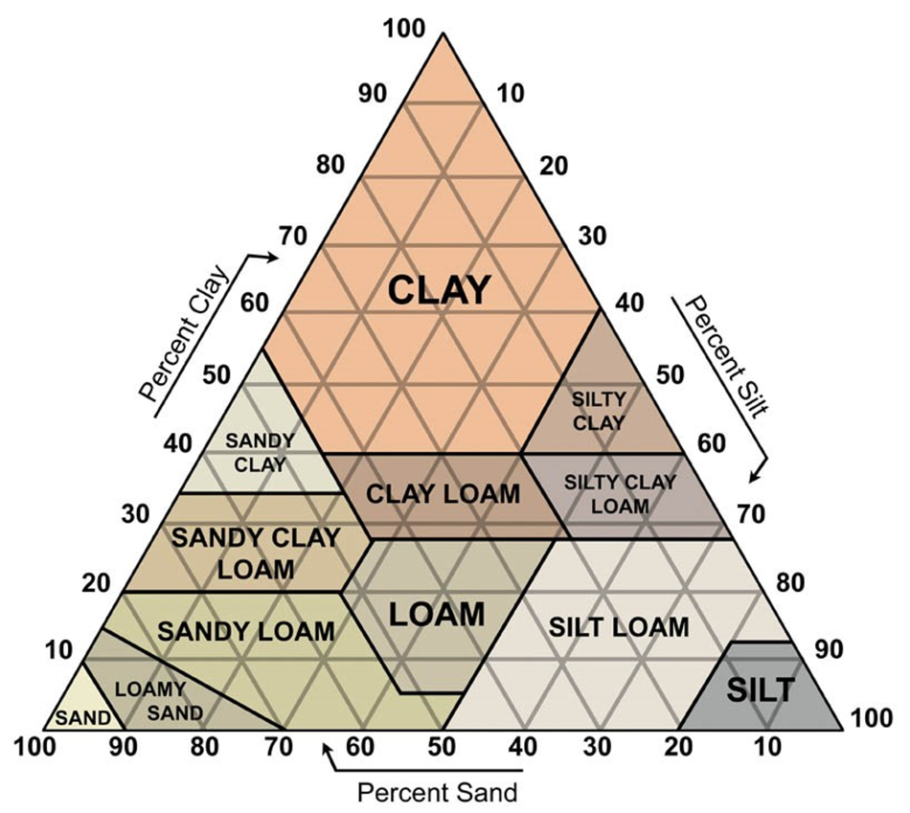
Physical: Soil texture

Slide 49
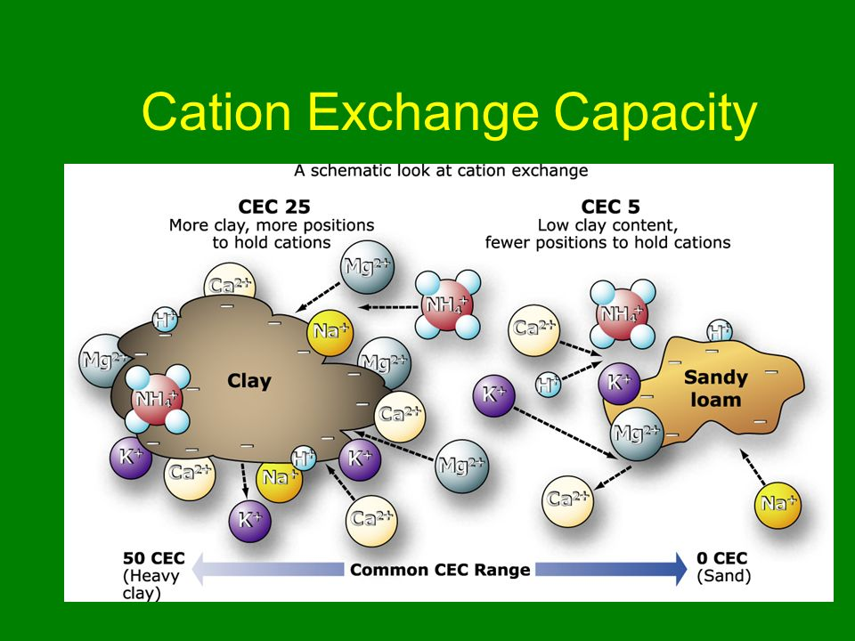

Slide 50
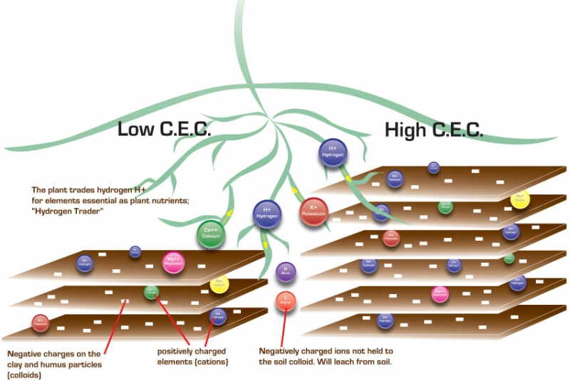

Slide 51
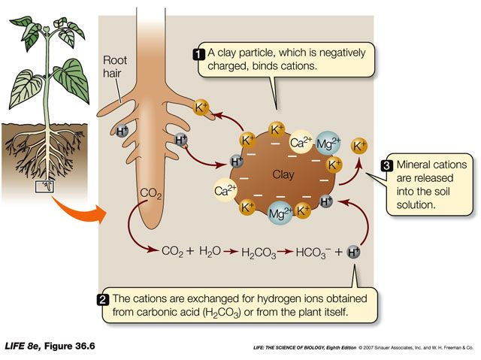
Chemical: Cation Exchange Capacity

Slide 52
Biomes

Slide 53
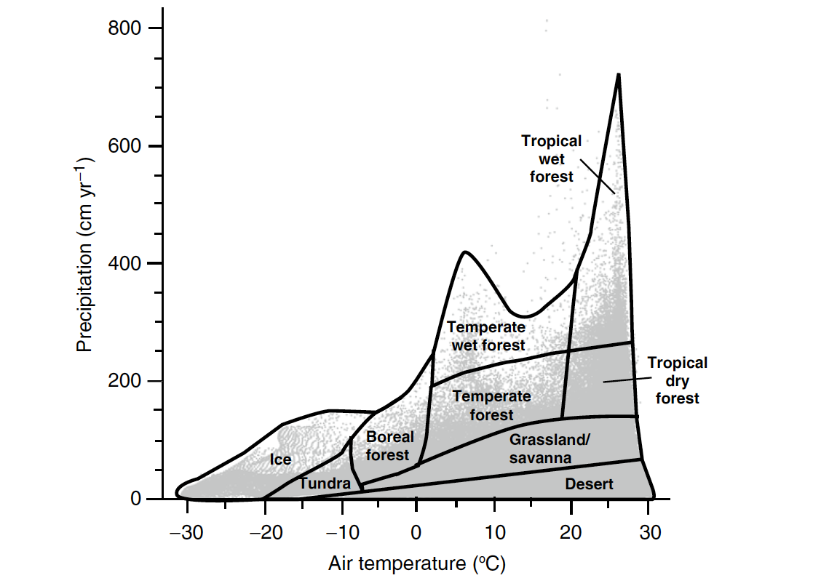
Climate determines biome distributions

Slide 54
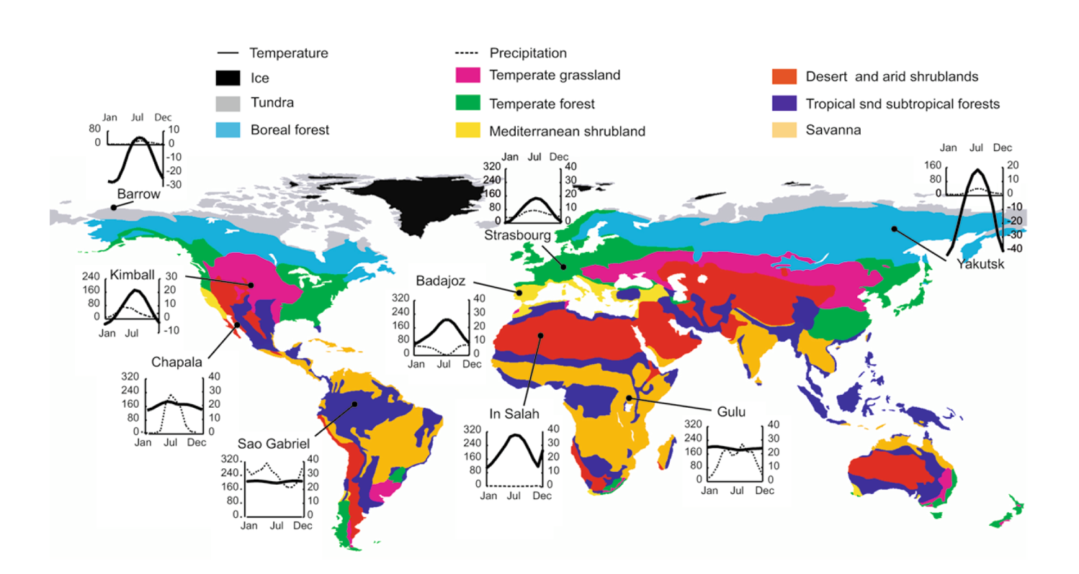
Biome distributions on Earth

Slide 55
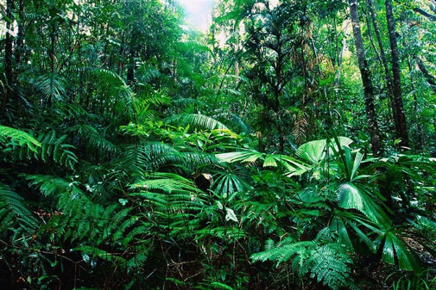
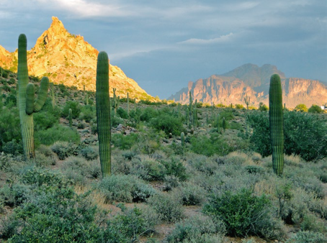
Characteristics of Biomes
Tropical Rainforest
Species diverse
Nutrient poor
Consistent climate
Desert
Bare soil
Calcium carbonate soils (basic)
Inconsistent climate

Slide 56
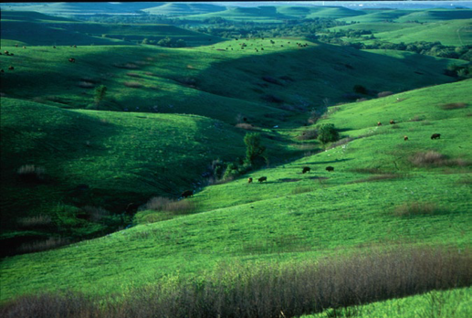
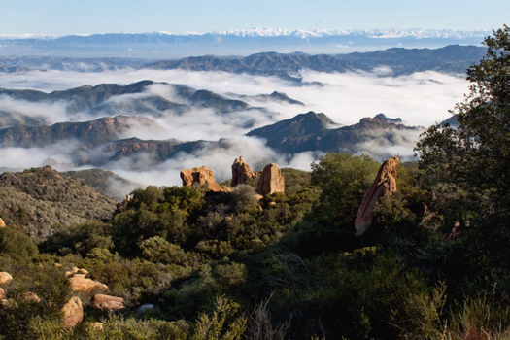
Temperate Grasslands
Clay soils
Deep soil carbon layer
Fire prone
Mediterranean shrublands
One of the most endangered habitats
Many endemic species
Only in coastal areas

Slide 57
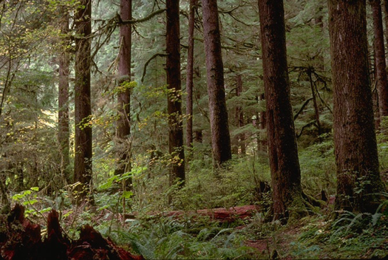
Temperate forests
Relatively species rich
Can have deciduous and non-deciduous trees
Taiga (Boreal forests)
Species poor
NPP in growing season can be as large as tropical forests
Experiencing warming at faster rates

Slide 58
What is our biome?

Slide 59
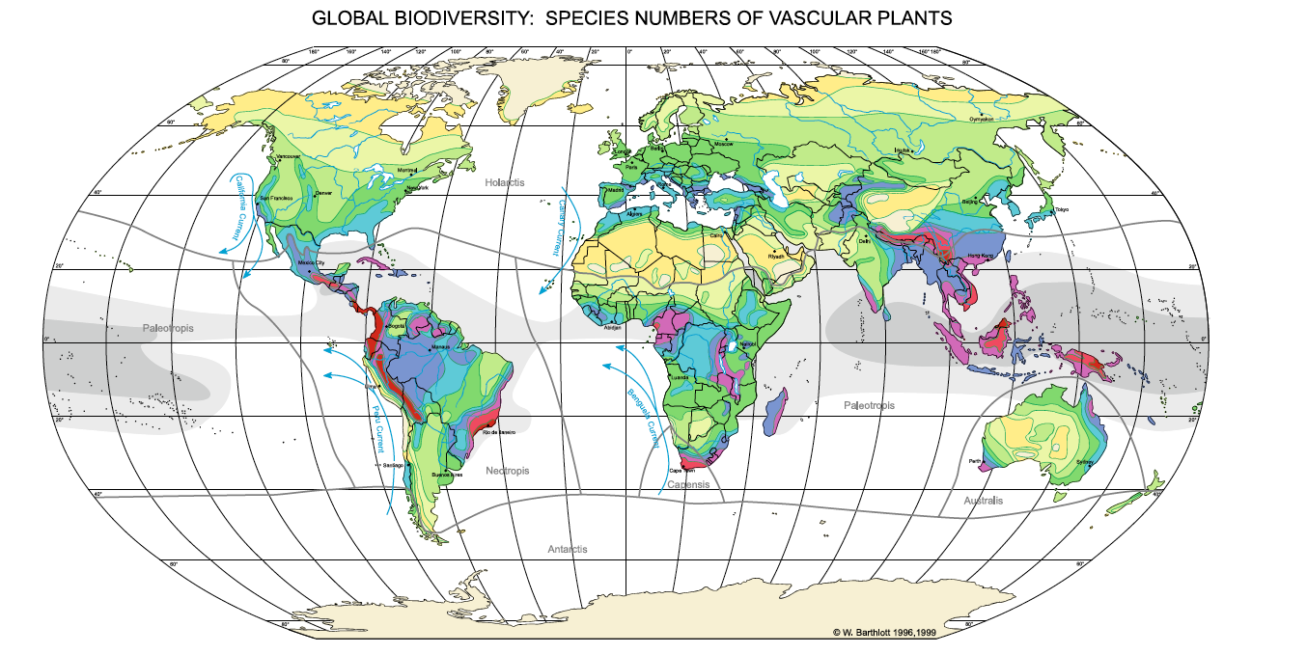
Latitudinal diversity gradient
Applies to plants and animals, but not necessarily microbes

Slide 60
Latitudinal diversity gradient
WHY?????
Applies to plants and animals, but not necessarily microbes

